Slide 1
Auto Enrolment - Practical Tips
Pat Strods and Devila Rabadia

Slide 2
Agenda
Background
Who is responsible?
Payroll compliance!
What is auto enrolment?
Who is affected?
When does this apply?
What do I have to do?
How much do I have to contribute?
In summary

Slide 3
Background
Ageing population
People are living longer
There are currently four people of working age for every pensioner ⇨ by 2050 there will be just two
Millions of people are under-saving for their retirement
The government has insufficient resources to pay for the rising pension costs

Slide 4
Background
In 2001 HMRC introduced The Stakeholder pension scheme idea
Any employer who had more than 5 staff had to provide a scheme
……that didn’t work!
Because apathy rules!
Individuals had to join and opt in
There was no obligation to join the scheme
So no real take up

Slide 5
Who is responsible?
YOU!!
But
It could also be:
HR
Payroll
Finance

Slide 6
Payroll Compliance – Auto Enrolment
Set by the pensions regulator
Fines are likely to be:
£50 per day for small employers
and up to £10,000 per day for employers with more than 500 staff!!

Slide 7
What is auto enrolment?
New legal obligation
Introduced in October 2012
Providing workplace pensions to all workers
And everyone is included
No minimum number of staff
Employers and workers have minimum contributions

Slide 8
Who is affected?
EVERYONE!
Any person employed by your business has to be assessed every time you process payments to them.
This can also affect workers and contractors to your business and will depend on their contract with you

Slide 9
Who is affected?
Earnings | Age (inclusive)
 | 16 – 21 | 22 – SPA* | SPA* - 74
Lower earnings threshold or below £486 per month/£5,824 per annum | Entitled worker
More than lower earnings threshold up to an including the earnings trigger for automatic enrolment | Non-eligible jobholder
Over earnings trigger for automatic enrolment £833 per month/£10,000 per annum | Non-eligible jobholder | Eligible jobholder | Non-eligible jobholder
*State pension age

Slide 10
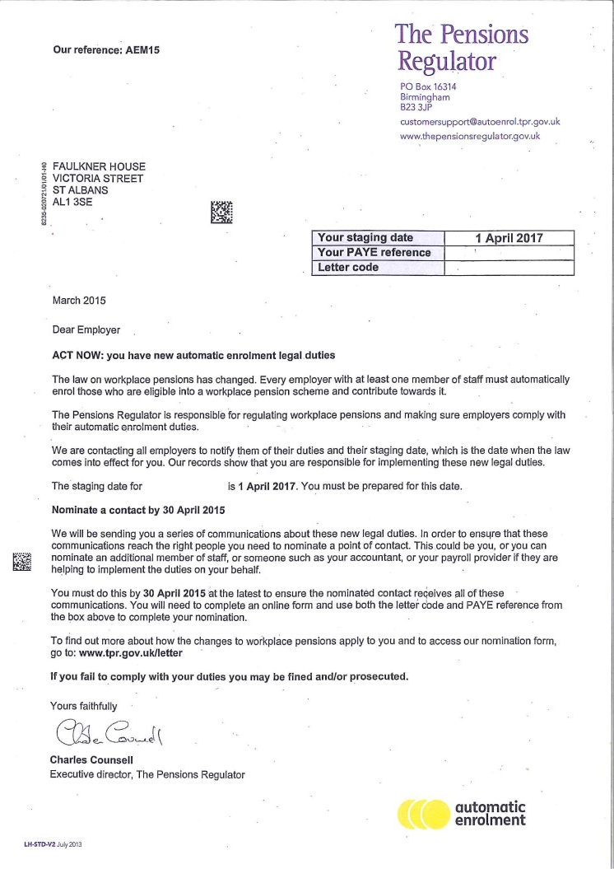
When does this apply?
Have you had your
first letter from The
Pensions Regulator
(TPR)?

Slide 11
When does this apply?
So what do we do now?
Do you have an existing pension scheme for your staff?
Is it Auto Enrolment (AE) compliant?

Slide 12
Clear plan, brighter wealth
Auto enrolment – January 2017
Jon Hussey – Financial Planning Director

Slide 13
Auto Enrolment : Action Plan
Introduction
Post-Staging Date
Pre-Staging Date
Q&A
At Staging Date
Contact details

Slide 14
Introduction to Auto Enrolment
12 Months before staging date
First and foremost: Find out what your staging date will
be
Based on number of people in employer’s largest PAYE scheme
Letters sent by Pensions Regulator
You nominate a ‘primary contact’
What does it involve?

Slide 15
Introduction to Auto Enrolment
9 Months before staging date
Find out who you need to enrol
Three different categories of staff
Assessed based on their ages and how much they earn

Slide 16
Introduction to Auto Enrolment
9 Months before staging date
Understand how much you will need to contribute
Employer needs to pay a regular minimum contribution into staff pension scheme
Based on qualifying earnings
Between £5,824 and £43,000 for 2016/17
Decide what basis of earnings and any appropriate waiting periods you want to use

Slide 17
Introduction to Auto Enrolment
Dates | Employer Min Contribution | Jobholder Contribution | Tax relief on Jobholder Contribution | Total
Before *05/04/18 | 1% | 0.8% | 0.2% | 2%
*6 April ‘18 to 5 April ‘19 | 2% | 2.4% | 0.6% | 5%
*6 April Onwards | 3% | 4.0% | 1.0% | 8%
* Subject to Parliamentary approval

Slide 18
Introduction to Auto Enrolment
6 Months before staging date
Check your staff records and payroll process
Payroll software compatible with all auto enrolment tasks
Lumin Wealth select a pension scheme provider
Communicate with your workforce The earlier the better
We can provide templates : Payslips, Posters

Slide 19
Introduction to Auto Enrolment
At your staging date
Pension scheme is set up, carry out formal staff assessment
We recommend you use your payroll provider
We send information to pension scheme provider
Six weeks to automatically enrol employees who are eligible
Write to each staff member after staging date to provide AE information
Staff members receive joiner packs

Slide 20
Introduction to Auto Enrolment
You are up an running, what next?
Uploading payroll files to deduct and pay contributions
Manage any opt-outs
Re-enrolment of any opt-out every 3 years
Provide a declaration of compliance to The Pensions Regulator

Slide 21
Introduction to Auto Enrolment
Summary: What we do
Help you analyse your existing arrangements
Advise which scheme/provider is best for you
Help you communicate with your staff
Set up your Auto enrolment scheme prior to staging
Set up communication between you, your payroll and your scheme provider

Slide 22
Introduction to Auto Enrolment
Any Questions?

Slide 23
Clearly us… Clear principles Clear services Clear costs Clear decision… Brighter wealth designed around you.

Slide 24
What do I have to do?
So we now have our scheme
As part of that set up we will have decided what contributions we intend to make
Every time a payment is made to a worker that worker is required to be assessed

Slide 25
What do I have to do?
The process of assessment has to take place
Every time you make a payment to an employee/worker
Why?
And

Slide 26
What do I have to do?
In order to assess your workers
You need to process your payroll
Assess your staff
And
Then re-run your payroll to incorporate the contributions

Slide 27
What do I have to do?
Letters have to be sent to staff
There are strict deadlines for the letters to be sent out
Pension deductions need to be reported to the Scheme Provider
Payment made
And process opt in and opt out requests

Slide 28
What do I have to do?
Scared yet?!!

Slide 29
How much do I have to contribute?
Qualifying earnings (Earnings between £5,824 and £43,000)
Date | Employer minimum | Employee could pay | Total required
From staging date to 5 April 2018 | 1% | 1% | 2%
6 April 2018 to 5 April 2019 | 2% | 3% | 5%
6 April 2019 onwards | 3% | 5% | 8%
* Subject to Parliamentary approval

Slide 30
How much do I have to contribute?
Tier 1 – Pensionable pay = basic pay (excludes overtime, bonuses and other variable or non-basic elements)
Date | Employer minimum | Employee could pay | Total required
From staging date to 5 April 2018 | 2% | 1% | 3%
6 April 2018 to 5 April 2019 | 3% | 3% | 6%
6 April 2019 onwards | 4% | 5% | 9%
* Subject to Parliamentary approval

Slide 31
How much do I have to contribute?
Tier 2 – Pensionable pay = 85% of total earnings
Date | Employer minimum | Employee could pay | Total required
From staging date to 5 April 2018 | 1% | 1% | 2%
6 April 2018 to 5 April 2019 | 2% | 3% | 5%
6 April 2019 onwards | 3% | 5% | 8%
Tier 3 – Pensionable pay = total earnings (all pay providing that all earnings are pensionable)
Date | Employer minimum | Employee could pay | Total required
From staging date to 5 April 2018 | 1% | 1% | 2%
6 April 2018 to 5 April 2019 | 2% | 3% | 5%
6 April 2019 onwards | 3% | 4% | 7%
* Subject to Parliamentary approval

Slide 32
Help what do I do?

Slide 33
In Summary
Set up a scheme
Decide what contributions and on what basis you want to make the contributions
Decide who will be responsible for implementation
Communicate with your employees and workers
Decide whether you are going to deal with the AE process

Slide 34
Can we help?
Yes we can!

Slide 35
Contacts: Pat Strods on 01727 736130 or by email on
ps@rayneressex.com Devila Rabadia on 01727 736138 or by email on devila.rabadia@rayneressex.com Website: www.rayneressex.com
Disclaimer: Please note that this presentation is not intended to give specific technical advice and should not be construed as doing so. It is designed to alert clients to some of the issues and not intended to give exhaustive coverage of the topic. Professional advice should always be sought before action is either taken or refrained from as a result of information contained herein.

